Slide 1

A Comprehensive Survey on Transfer Learning
$αβnormal$ Distri$β$ution
AC295/CS115
Notes:
Welcome to the talk on "A Comprehensive Survey on Transfer Learning" by Abnormal Distribution!

Slide 2
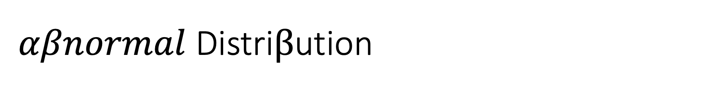
$αβnormal$ Distri$β$ution
Eduardo Peynetti
Jessica Wijaya
Rohit Beri
Stuart Neilson
Notes:
This is us, Eduardo, me, Rohit, and Stuart

Slide 3
Contents
Overview of the TL Survey
Deep-dive into SFA
Code Demo
Q&A
Ed Questions
Special Considerations
Notes:
Over the next 20 minutes we will share an overview of Transfer Learning Survey; do a deep dive into SFA, discuss some special considerations, and answer your questions

Slide 4
Overview of the Transfer Learning Survey (Zhuang et al.)
Notes:
Let’s begin with an overview

Slide 5
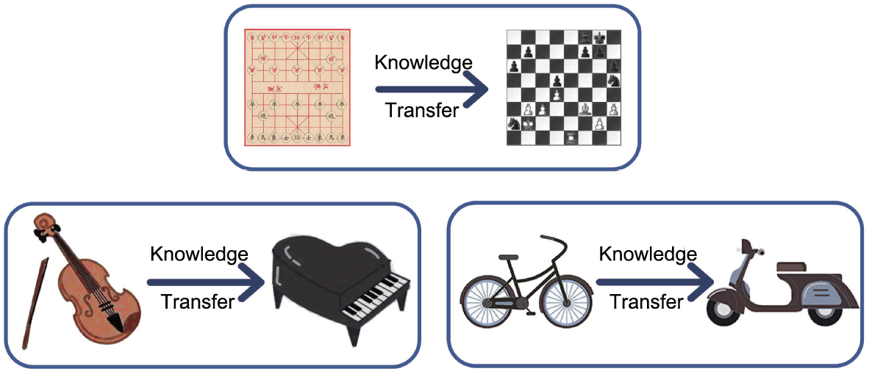
Transfer Learning
Generalization of Experience
Categories of Transfer Learning
Prerequisite
There needs to be a connection between two learning activities
Homogeneous TL
Source and Target in the same feature space
Differ only in marginal distributions
Heterogeneous TL
Domains have different feature space
Requires feature space adaptation in addition to distribution adaptation
RTL, LTL, OTL
Notes:
Transfer Learning is Generalization of Experience. However, it requires a connection between two learning activities.
For example if you know how to bicycle, it is usually easier to learn how to ride motor-cycle.
Transfer Learning can be divided into various categories, Homogeneous, Heterogeneous, Reinforcement Transfer Learning, etc.
In a homogenous task, the source and the target domain have the same feature space. They’ll just differ in marginal distributions. In case of a heterogenous tasks, the source and domain have different feature space.
However, this survey focuses on Homogeneous Transfer Learning. Anything in brown text/cell is not covered in the paper.

Slide 6
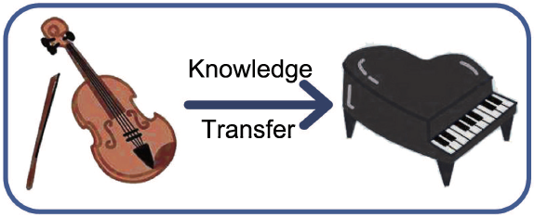
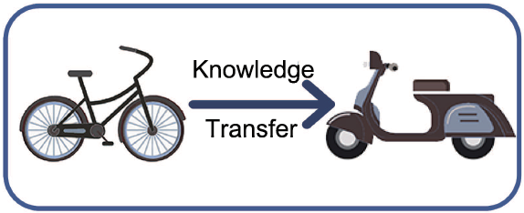
Not Transfer Learning
CANNOT TRANSFER
NEGATIVE TRANSFER
Knowing Good Spanish
Makes it difficult to learn French
Notes:
Transfer learning doesn’t ALWAYS work. We may not have any information that can be shared between the source and the target. For example, knowing how to play a musical instrument cannot make learning how to ride easier.
On the other hand, Negative Transfer Learning happens when learning one task makes it harder to learn other. For example, if you know Spanish well, learning French can be harder, though the languages are similar

Slide 7
Four views of Transfer Learning
Transfer Learning
Problem
Solution
Data
Model
Label Information Availability
Feature Space Distributions
Instance Based
Feature Based
Parameter Based
Relational Based
Strategy
Objective
Strategy
Objective
Notes:
There are 4 different aspects to Transfer Learning.
- The Problem we are trying to solve
- The Solution we are adopting
- The approach of the solution could be:
- Data-based Interpretation
- or, Model based Interpretation

Slide 8
TL Problem Categorization
Transfer Learning
Problem
Solution
Data
Model
TL Problem
Label Information
Feature and Label Space
Transductive
Inductive
Unsupervised
Only available for Source
Available for Source & Target
Not Available
Homogeneous TL
Heterogeneous TL
Similar Feature and Label Space
At least one of Feature or Label Space is dis-similar
Notes:
Based on the Problem: Transfer learning can be divided into following categories:
Transductive: when only Source Domain Labels are available
Inductive: When both Source and Target Domain Labels are available
Unsupervised: When No Label Information is available
Homogeneous: When source and target domain have Similar Feature Scape:
Heterogenous: When Feature Space is Dis-similar

Slide 9
TL Solution Categorization
Transfer Learning
Problem
Solution
Data
Model
TL Solution
Instance Based
Feature Based
Parameter Based
Relational Based
Symmetric Transformation
Asymmetric Transformation
Transfer at Model/Parameter Level
Transfer of logical relationship or rules learned
Instance Weighting Strategy
Transform source to match target
Transform source and target to common space
Notes:
The paper also categorizes transfer learning solutions into 4 board categories:
- Instance based,
- Feature Based which could be symmetric or asymmetric
- Parameter Based
- and Relational Based
Instance Based and Feature Based solutions largely fall under data-based interpretation.
The parameter-based solutions primarily fall into model-based interpretation.
There is also relational-based solutions, but the paper does not cover those.

Slide 10
Data-based Interpretation
Transfer Learning
Problem
Solution
Data
Model
Objective
Strategy
Strategy
Instance Weighting
Estimation Method
Heuristic Method
Feature Transformation
Augmentation
Reduction
Alignment
Replication
Stacking
Mapping
Clustering
Selection
Encoding
Subspace
Statistic
Spectral
Notes:
As discussed earlier, transfer learning solutions can be either data-based interpretations or model-based interpretations.
Interpretations can be divided into two parts:
- Strategy
- Objective
Strategy refers to the approach and the Objective usually refers to the optimization function, i.e. KL divergent, Max-Mean Discrepancy
Data-based strategy can be divided into 2 different categories:
- Instance Weighting
- Feature Transformation
Instance weighting techniques weigh the instances of the source domain to match what we have in the target domains.
Feature transformations tries to adapt feature space to reduce the gap between the source or target domains. 3 main ways to do this are augmentation, reduction, and alignment

Slide 11
Data-based Interpretation
Transfer Learning
Problem
Solution
Data
Model
Strategy
Objective
Objective
Space Adaptation
Feature Space
Label Space
Distribution Adaptation
Type
Marginal Distribution
Conditional Distribution
Joint Distribution
Measurement
Max Mean Discrepancy
KL Divergence
JS Divergence
Bregman Divergence
Data Property Preserve/Adj.
Statistical Property
Mean
Covariance
Geometric Structure
Manifold
Cluster
Notes:
Now let's look at the Objective for data-based interpretations. Objective fall into three different categories:
- Space Adaptation: Not a focus on this paper
- Distribution Adaptation:
-Distribution adaptation could entail adapting marginal, conditional or joint distribution. We can make use of several different metrics like KL Divergence, JS Divergence, Max Mean Divergence
- Data Property Preservation/Adjustments:
- Here our aim to preserve either some statistical property of the data or the geometric structure of the data

Slide 12
Model-based Interpretation
Transfer Learning
Problem
Solution
Data
Model
Strategy
Model Control
Parameter Control
Model Ensemble
Consensus Regularizer
Domain-dependent Regularizer
Sharing
Restriction
Voting Strategy
Weighting Strategy
Model Selection
Deep Learning Techniques
Traditional DL
Adversarial DL
Objective
Prediction Making
Domain Adaptation
Pseudo Label Generation
Notes:
Now let's look at model-based interpretations.
There are 4 type of strategies:
- Model control
- Parameter control
- Ensemble methods
- and Deep learning techniques
These strategies can be further divided into sub-categories, For example deep learning strategies can be adversarial or non-adversarial.
Objectives in case of model-based interpretation usually fall into 1 of the 3 main goals:
- Prediction making
- Domain adaptation
- and pseudo-label generation

Slide 13
Four Pillars of Transfer Learning
Transfer Learning
Problem
Solution
Data
Model
Label Information Availability
Feature Space Distributions
Instance Based
Feature Based
Parameter Based
Relational Based
Strategy
Objective
Strategy
Objective
Notes:
The 4-pillar framework brings a great insight into Transfer Learning process.

Slide 14
Summary
Key Findings
Suitability of the algorithms is domain dependent
Adversarial models tend to outperform others
Co-Clustering can be powerful tool to uncover common latent space
What’s missing?
How to avoid negative transfer?
Theoretical underpinnings for Transfer Learning
How to do model selection?
Notes:
So what are the key learnings from the survey apart from the 4-pillar framework?
- One, transfer learning algorithms are domain dependent.
- Two, adversarial models tend to outperform traditional approaches
- Three, co-clustering can be powerful tool to uncover common latent spaces.
But a lot is missing.
-Survey does not cover anything on negative transfers.
-Or shed any light on theoretical underpinnings of Transfer Learning.
-And sadly it doesn’t answer the most important question: How do we do model selection?

Slide 15
Deep Dive – Spectral Feature Alignment (Pan et al.)
Notes:
Now let’s do a deep dive into a Transfer Learning Algorithm: Spectral Feature Adaptation or SFA in short

Slide 16
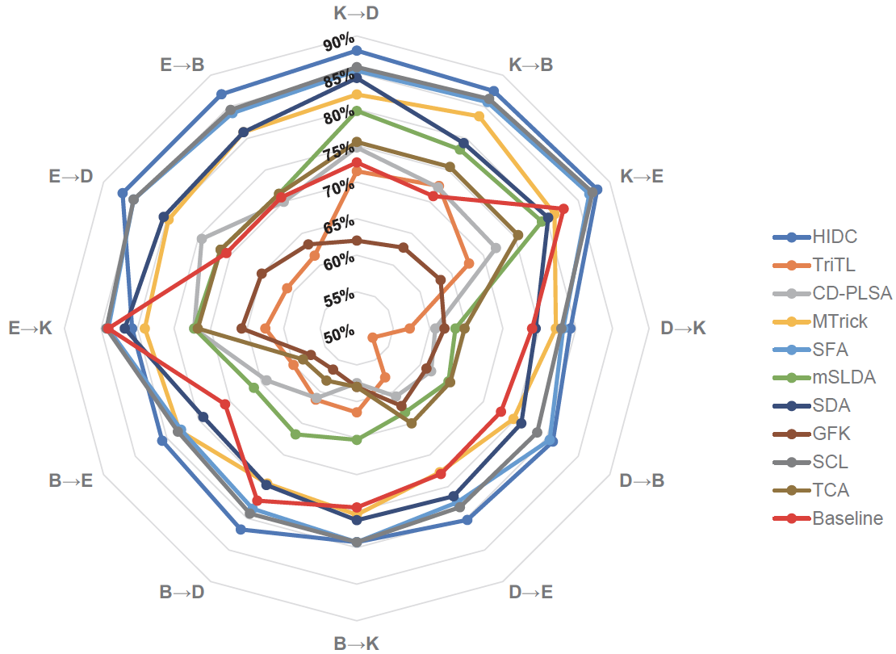
Amazon Reviews
Models that performed well in all 12 experiments
HDIC: feature reduction – clustering
SCL: feature selection
SFA: feature alignment
MTrick: feature reduction – clustering
SDA: feature encoding
Source domain: electronics or kitchen
All models did well
Domains may contain more transferable information
Notes:
We look at the results of the experiments conducted by survey authors on Amazon Reviews dataset.
We recreate 3 of the top 5 experiments - Structured Correspondence Learning, Spectral Feature Alignment & MTrick

Slide 17
Amazon Reviews
Models that performed well in all 12 experiments
HDIC: feature reduction – clustering
SCL: feature selection
SFA: feature alignment
MTrick: feature reduction – clustering
SDA: feature encoding
Source domain: electronics or kitchen
All models did well
Domains may contain more transferable information
Notes:
We will share our insights about SFA, a feature alignment algorithm

Slide 18
Spectral Feature Alignment
Challenge
Mismatch between domain-specific words in source and target domains
Solution
Adapted Spectral clustering algorithm, based on graph spectral theory
Sentiment classifier trained on the source domain may not work well when directly applied to the target domain
Co-align domain-specific and domain-independent words into a set of feature-clusters
Notes:
SFA uses Spectral Clustering Algorithm to co-align domain-specific and domain-independent features into clusters. This reduces the gap between domain-specific features on source and target domains.

Slide 19
Spectral Feature Alignment
Spectral Feature Alignment
Unsupervised
Feature-based Symmetric Transformation
Data-based Feature Alignment with Augmentation & Clustering
Model (NA)
Notes:
SFA is an Unsupervised, Feature based, data-based interpretation approach

Slide 20
TL Problem Categorization
Transfer Learning
Problem
Solution
Data
Model
TL Problem
Label Information
Feature and Label Space
Transductive
Inductive
Unsupervised
Only available for Source
Available for Source & Target
Not Available
Homogeneous TL
Heterogeneous TL
Similar Feature and Label Space
At least one of Feature or Label Space is dis-similar
Notes:
From problem perspective, SFA doesn’t not need label information and hence is an unsupervised strategy.
However, the amazon review dataset has label information for both the domains.

Slide 21
TL Solution Categorization
Transfer Learning
Problem
Solution
Data
Model
TL Solution
Instance Based
Feature Based
Parameter Based
Relational Based
Symmetric Transformation
Asymmetric Transformation
Transfer at Model/Parameter Level
Transfer of logical relationship or rules learned
Instance Weighting Strategy
Transform source to match target
Transform source and target to common space
Notes:
SFA is a feature-based symmetric solution.
It transforms both the source and the target domain-specific features into a common space

Slide 22
Data-based Interpretation
Transfer Learning
Problem
Solution
Data
Model
Objective
Strategy
Strategy
Instance Weighting
Estimation Method
Heuristic Method
Feature Transformation
Augmentation
Reduction
Alignment
Replication
Stacking
Mapping
Clustering
Selection
Encoding
Subspace
Statistic
Spectral
Notes:
SFA is a data-based interpretation approach.
It relies of spectral feature alignment which is based on Spectral Clustering Algorithm.
It also takes advantage of feature augmentation by stacking the original and transformed features together.

Slide 23
Data-based Interpretation
Transfer Learning
Problem
Solution
Data
Model
Strategy
Objective
Objective
Space Adaptation
Feature Space
Label Space
Distribution Adaptation
Type
Marginal Distribution
Conditional Distribution
Joint Distribution
Measurement
Max Mean Discrepancy
KL Divergence
JS Divergence
Bregman Divergence
Data Property Preserve/Adj.
Statistical Property
Mean
Covariance
Geometric Structure
Manifold
Cluster
Notes:
SFA uses clustering as an objective.
It aims for suitable adjustment in data properties to uncover common latent space for the source and target feature space.

Slide 24
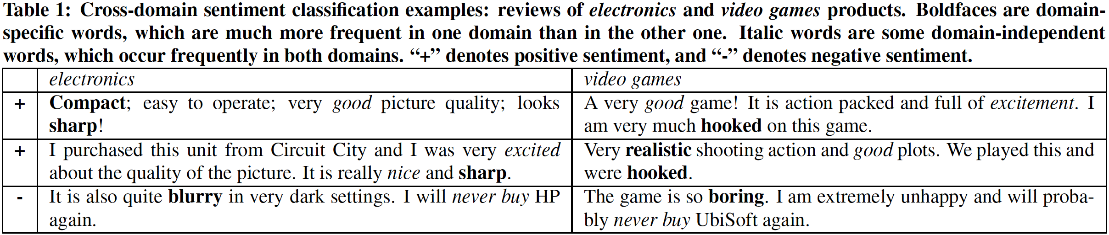
Cross-Domain Sentiment Classification
Notes:
Now let's look at an example to make things clearer.
Here are two different dataset - Electronics Reviews and Video Games Reviews
We can see the pertinent keywords are different for both the domains.
- sharp vs hooked
- compact vs realistic
- blurry vs boring
How do we get our models to make sense of these differences?

Slide 25
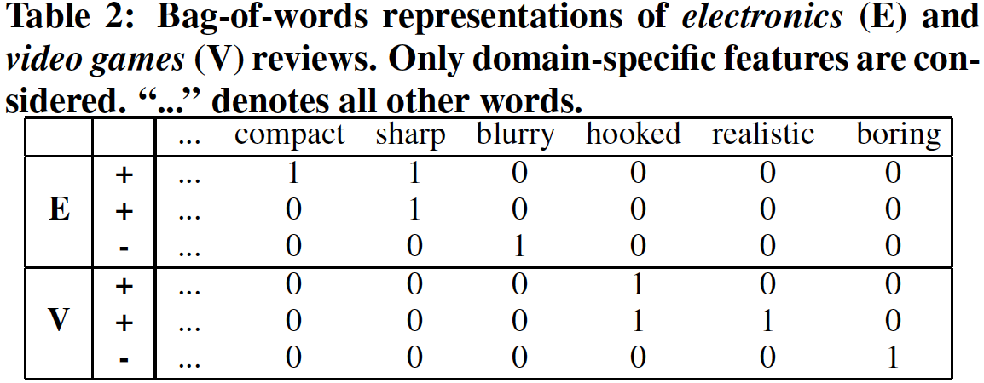
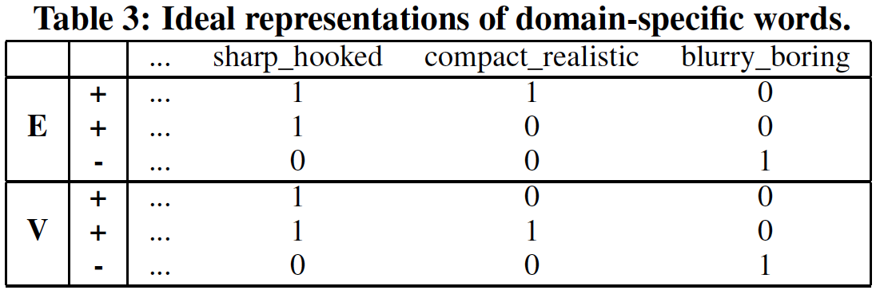
Cross Domain Sentiment Classification
What do we have?
What do we want
Notes:
Let's see what do we have?
- We have a bag of words representation on the left.
What we need is the ideal representation on the right.
There we have a linkage between the domain-specific words from across the domains
- sharp is linked to hooked
- compact is linked to realistic
- blurry is linked to boring

Slide 26
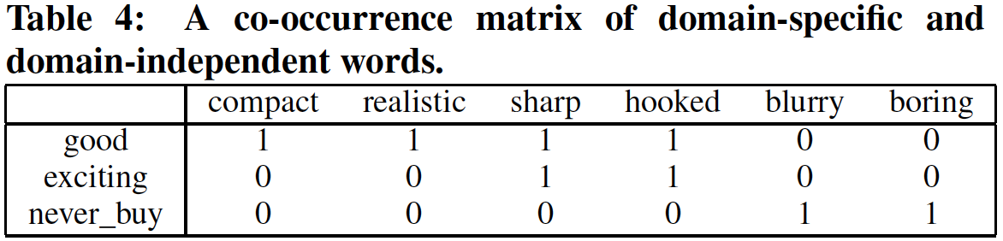
Cross Domain Sentiment Classification
How do we get there?
Intermediate Step
With the help of domain independent words as a bridge
By simultaneously co-clustering them in a common latent space
Notes:
How do we get there?
The answers is by using domain-independent words as a bridge and building a co-occurrence matrix
- also called adjacency matrix

Slide 27
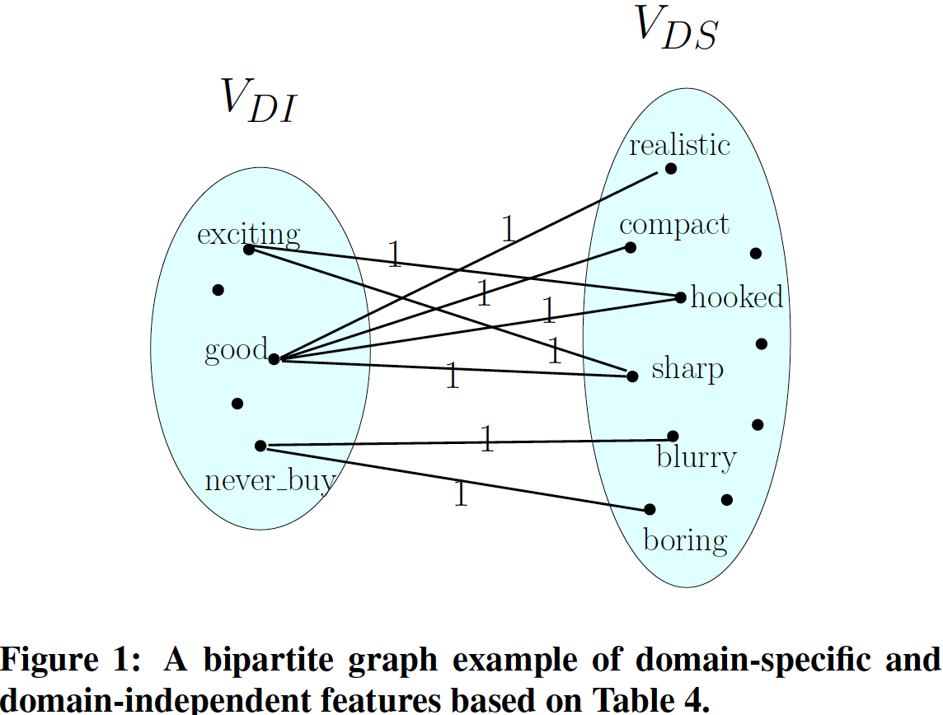
Cross Domain Sentiment Classification
Domain-Independent Feature Selection
Bipartite Feature Graph Construction
Three strategies
Based on their frequency in both domains
Based on the mutual dependence between features and labels on the source domain data
Modified mutual-information criterion
Notes:
First, we need to find domain independent feature, also called pivot features.
There are three different strategies to choose pivot features:
- We can use word frequency across the domains as a benchmark
- Or we can use techniques involving mutual information
Once we have selected pivot features, the rest of the features are termed as domain-specific features.
We can then easily construct the bipartite feature graph, a graphical representation of the co-occurrence/adjacency matrix

Slide 28
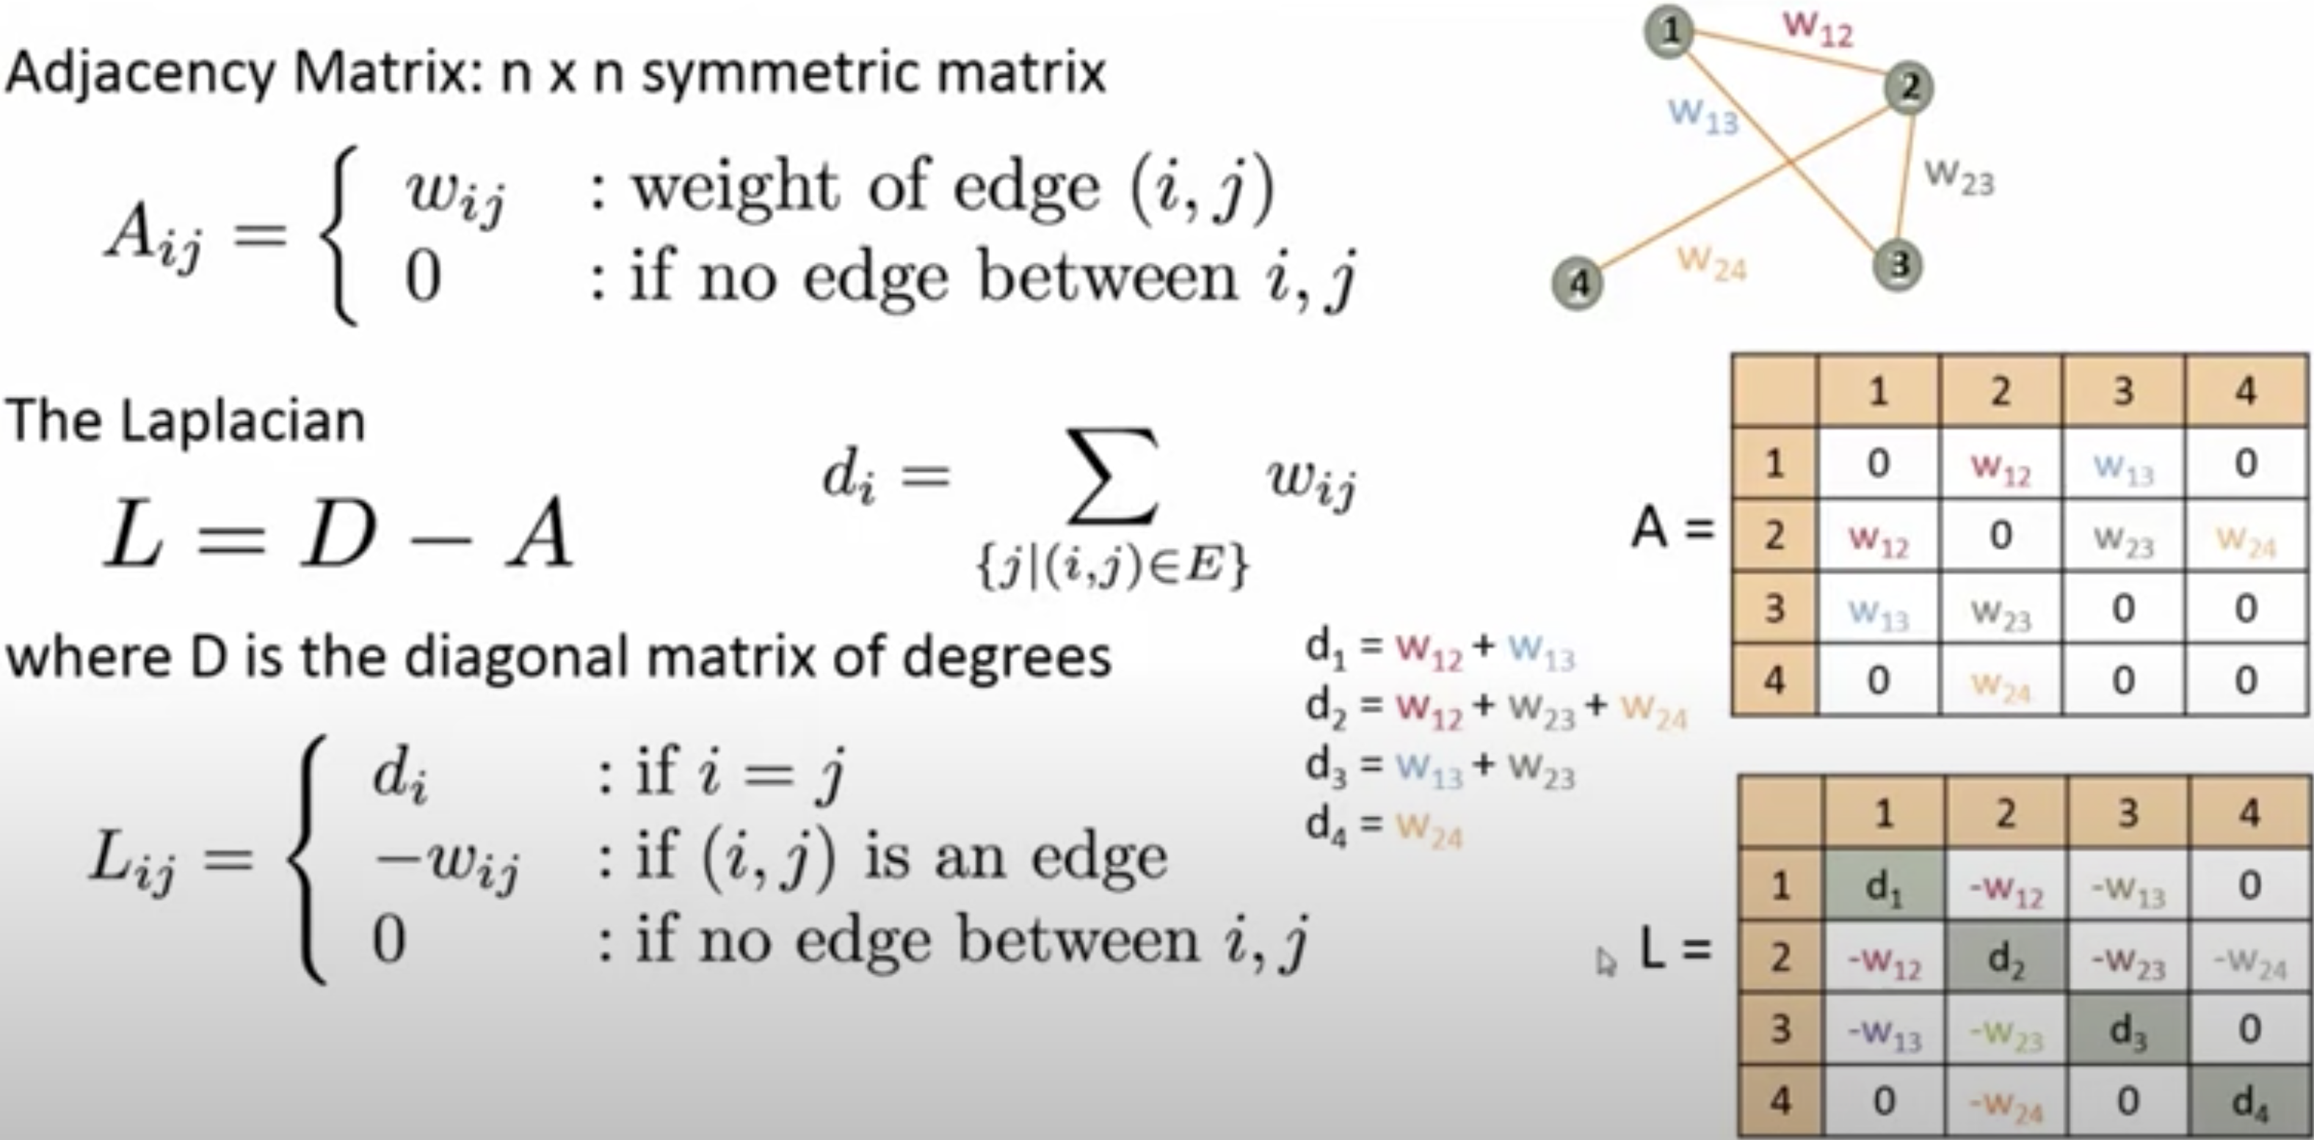
Spectral Clustering
Notes:
We then transform adjacency/co-occurrence matrix ( or A matrix) into Graph Laplacian Matrix (or L Matrix)

Slide 29
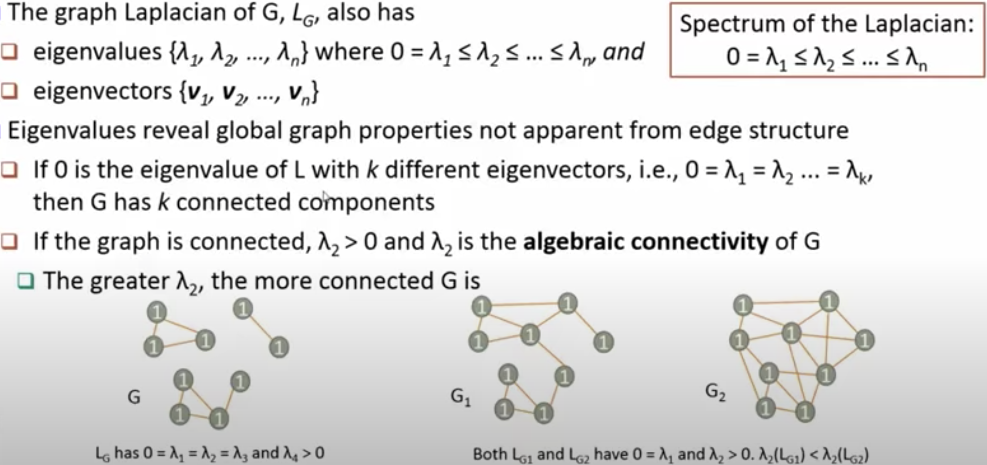
Spectral Clustering
Notes:
We then do eigenvalue decomposition of the Graph Laplacian i.e. L Matrix

Slide 30
Spectral Clustering
Notes:
The number of clusters is given by the number of the zero eigen values.
For example, in the first graph there are three clusters and three eigen values are equal to zero

Slide 31
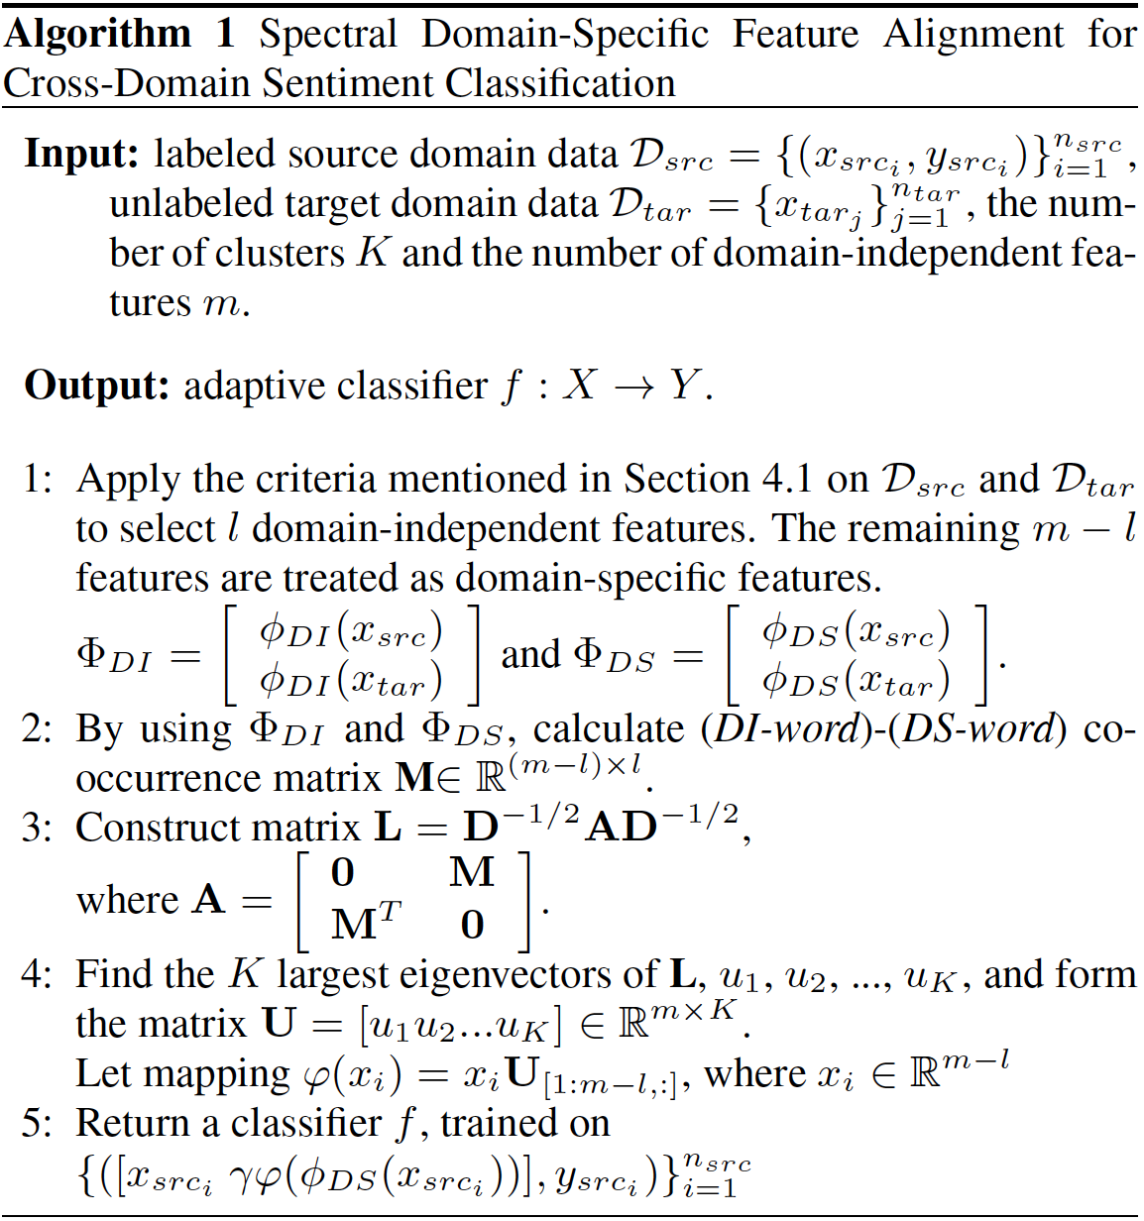
Spectral Feature Alignment - Algorithm
Select Pivot Features
Perform Spectral Clustering
Feature Augmentation
Training/Testing
Notes:
The clustered representation is then stacked with the original features and used an input for the training model.
We will share more about the implementation details of the SFA in the code demo

Slide 32
Code Demo
Notes:
Now we will take you through a short code demo

Slide 33
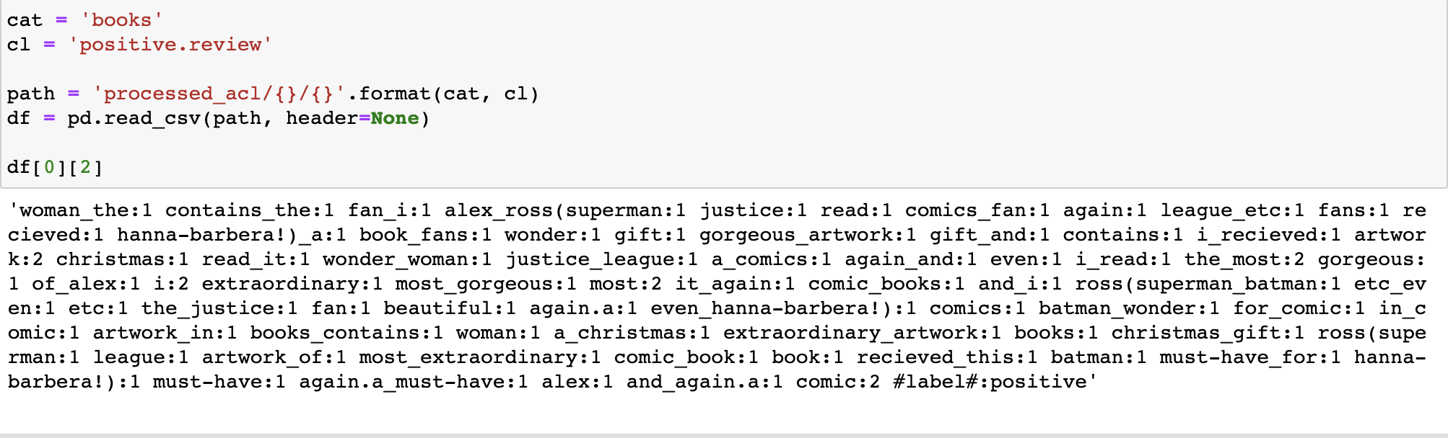
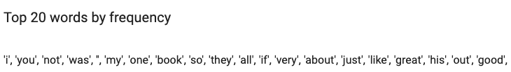
Data Parsing - Individual Data Point
Notes:
The dataset consists of 2000 labeled reviews, 1000 positive and 1000 negative, per item, as well as about 5000 unlabeled reviews per item. We have 4 items: Books, DVDs, Electronics and Kitchen Appliances.
Let’s first look at a sample of the data.
This is a positive book review in our database. The data is given to us as a dictionary of word counts and a label. From this data point we can infer that authors used bigrams in their experiments.
We looked at the top words by frequency in the dataset. Many of these words carry little discriminative power. For example, words like I, you, was, my. Also, from this list we presume that authors excluded StopWords from their analysis.
Our first task is to find domain-independent words, words that can be found in all contexts, and that are helpful to split or cluster the data. Words like gorgeous, must-have, etc.
Our next task is to find domain-specific words that also help us split the data, like fan, artwork.
The authors rely heavily on word frequency to make these decisions.

Slide 34
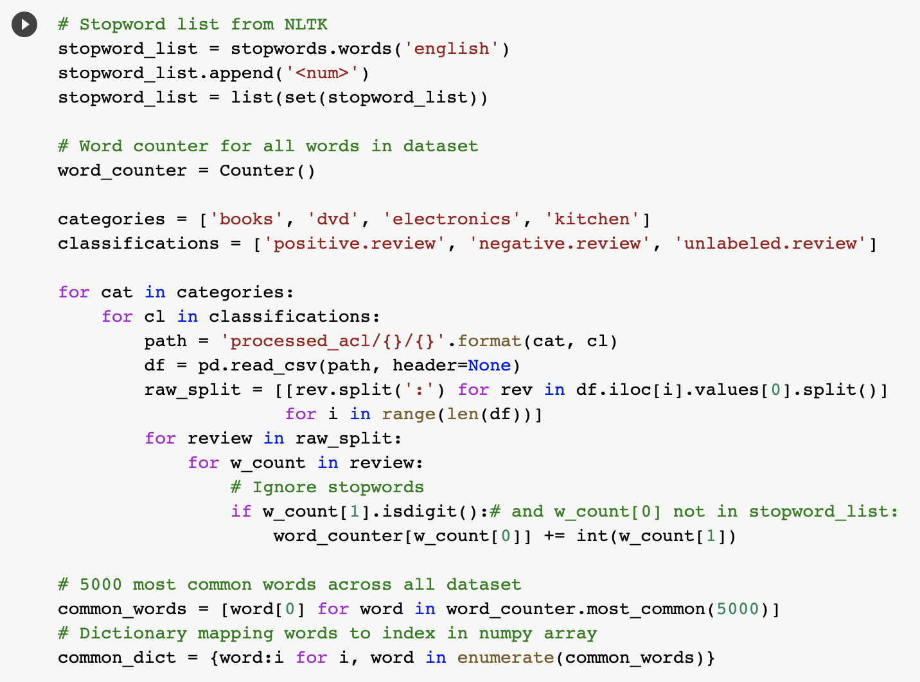
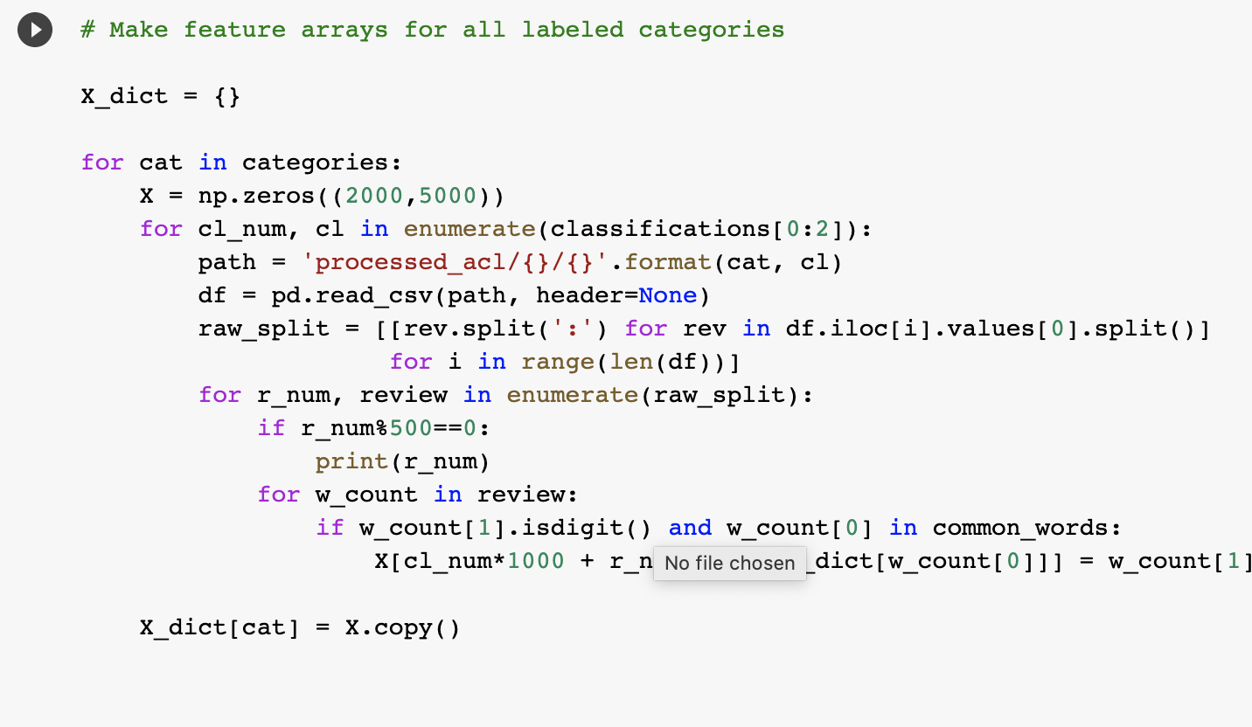
Data Parsing
Extracting Data
Creating Features from Labeled Data
Notes:
The repo code and the paper didn’t provide a method to process the data, just a link to the data source. The paper describes their feature selection process as: choose the 5000 most common words across all datasets. The fact that we don’t know their tokenization process means we couldn’t exactly replicate their experiments.

Slide 35
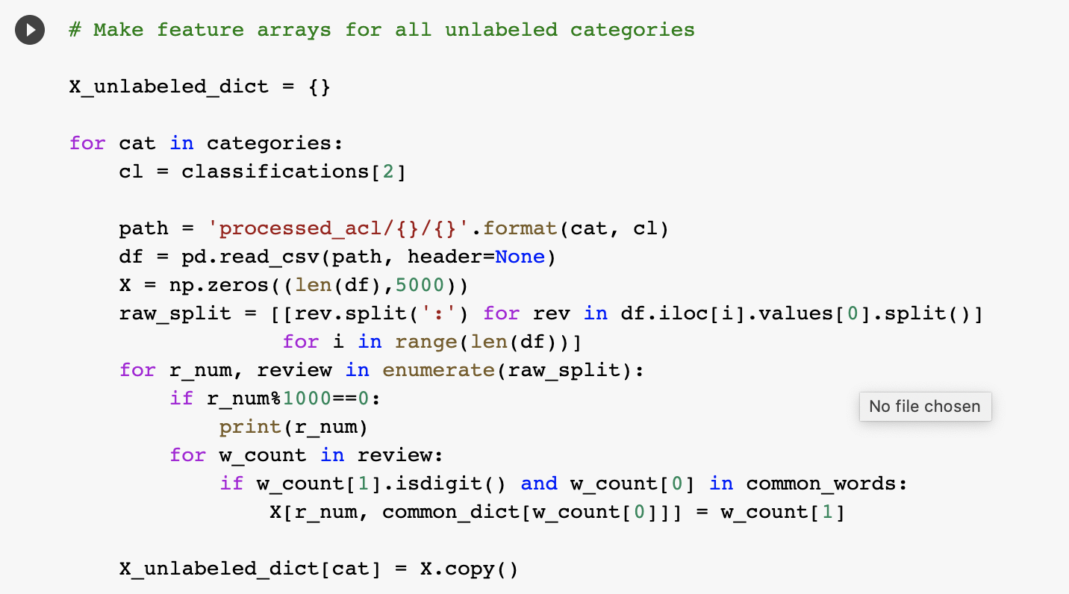
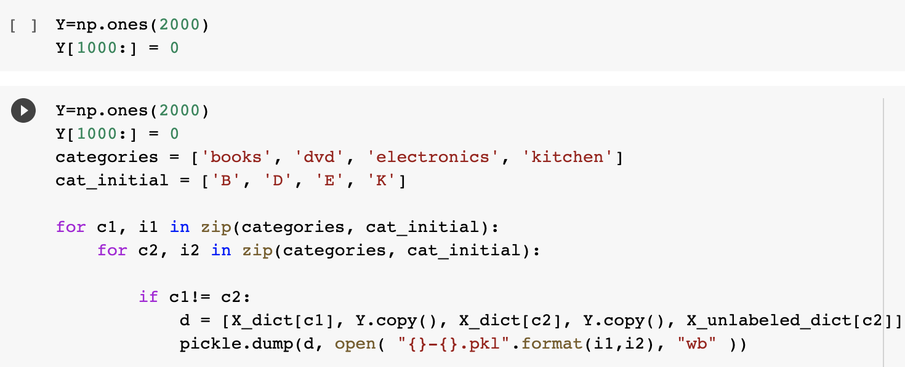
Data Parsing
Creating Features from Unlabeled Data
Saving Features Data
Notes:
We store the data as a bag of words in numpy arrays. This is the format that almost all of the algorithms in their repo follow. From 4 items, we end up with 12 combinations of source -> target data.

Slide 36
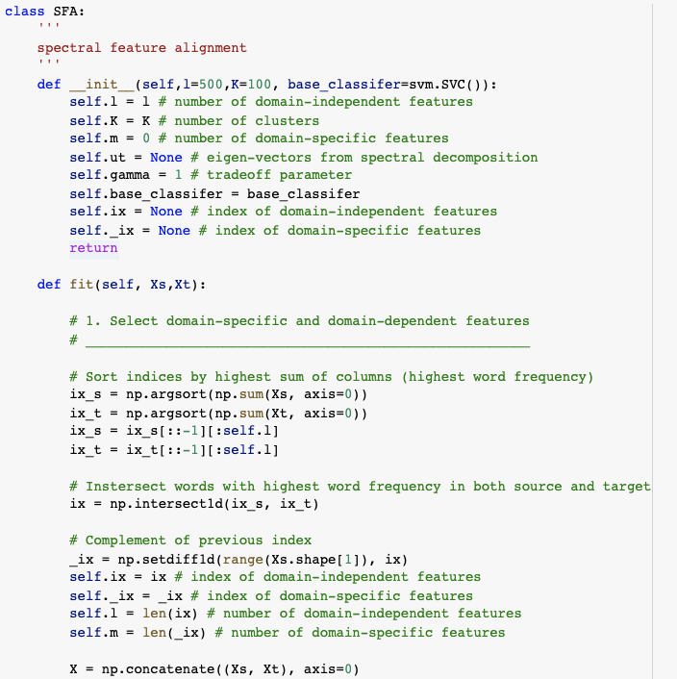
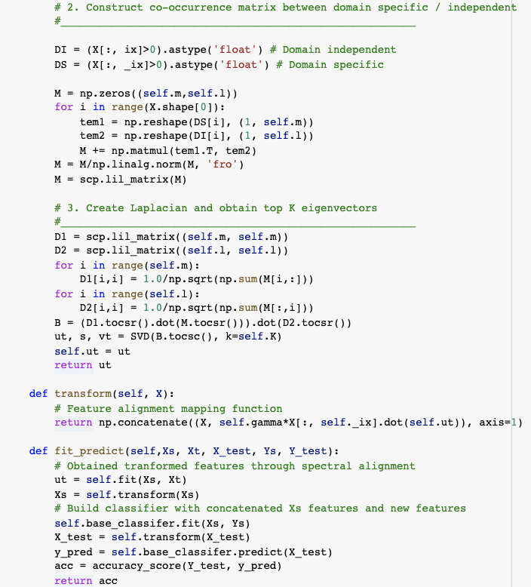
SFA Algorithm
Notes:
We use the hyperparameters provided in the repo. The code here is as provided by the authors but with comments by us.
In here they start with 500 domain-independent features and 100 clusters. The common features are chosen by looking at the 500 top words by frequency in source and target, and then reducing this number by looking at the intersection. The compliment of these words are the domain-specific features.
This doesn’t seem like the best way to do things for a couple reasons: As we saw, there are many common words with little discriminating power. We require picking many common words to be able to include enough relevant words.
After this, the algorithm builds a co-occurrence matrix, then the Laplacian, and from here they obtain the top 100 eigenvectors which become our new features. Again, Since they chose a high number of domain-independent features, they need to choose a high number of clusters to find enough relevant clusters. This could have been done more efficiently. The paper for SFAl proposes a few ways to do this such as using mutual information.
Finally, the eigenvectors are concatenated to the original features, and we have our augmented dataset

Slide 37
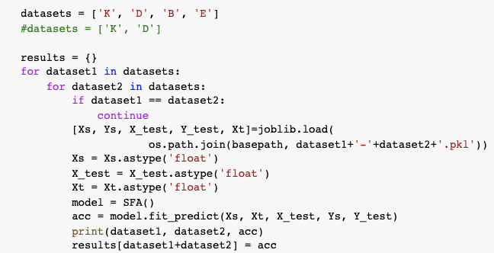
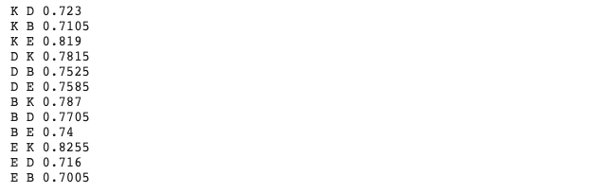
SFA Algorithm
Training
Accuracy
Notes:
Finally we run all combinations and obtain accuracies. Their code doesn’t provide much more than accuracies, but we can save the models to do further analysis later.

Slide 38
Overall Results
Survey Experiments
Our Experiments
Notes:
We compare our results to theirs. While we get results of similar magnitude, our results underperform in some cases and outperform in others. This is likely because we don’t perform the exact same preprocessing.
The feature selection might have had a very important role in determining the scores in their paper. For models like SCL, the choice of pivots is even more influential (they pick pivots as the top 10 words by frequencies). Some of the models have their own way of choosing features in a smart way (like using TF-iDF). So we think that you need to be careful taking their results at face value.

Slide 39
Insights
Data pre-processing, like tokenization, can affect transferability
Success dependent on proper choice of domain specific features
Models in this space are similar: feature choice -> clustering -> augmentation
Can achieve decent performance without labels
Notes:
Some insights we get from their work is that pre-processing, like tokenization, can have a crucial effect on transferability. If this step isn’t done properly, it will hurt your results. Also, results across models might not be comparable.
Feature selection in these models depends strongly on tokenization.
Another insight is that many of these models follow a similar pattern. They do some feature selection, use some clustering method based on these features, and then augment their original features with this new information.
Finally, we saw that you can achieve decent results in transfer learning using data without labels. The unlabeled data itself is rich enough to find structure that can help in the transfer learning task.

Slide 40
Pertinent Question
Data-based Interpretation
Model-based Interpretation
Improved Transfer Learning?
Notes:
Finally, for us, this paper raises one very pertinent question:
- Can we combine Data-based interpretations and model-based interpretation to improve the performance of transfer learning?
- For example, Will combining data-based interpretations (like Spectral Feature Alignment) with model-based interpretations (like Deep Learning Sentiment Model) give better outcomes for the target domain?

Slide 41
Special Considerations
Notes:
We will not share some interesting aspects of the experiments.

Slide 42

TL Survey GitHub Repo
Challenges
Part implementation in Python, part in MATLAB
Lack of information on data preprocessing for replication
Obsolete, sometime broken code and libraries
Notes:
The authors provided the code for running all of their experiments.
Unfortunately, some of that code was in Matlab.
One challenge we faced in replicating the experiments was text tokenization. The paper did not cover relevant details on data preprocessing which make exact replication impossible. Hence our results are different from theirs.
Some of the models that we attempted to replicate didn’t work, and it appears that this was due to for example having the wrong version of the Tensorflow library.
BinderHub would have been excellent choice here.

Slide 43
MATLAB
Why are we discussing MATLAB?
Authors provided the code for the algorithms
How to get around it?
Install MATLAB
Unfortunately, some of them are written in MATLAB
In folder /extern/engine/python/ under the MATLAB root, run python setup.py install
Need admin rights
Notes:
To be able to run the Matlab code from Python, you can install Matlab – which Harvard students can do for free - and then the libraries for the Python-Matlab engine can be installed from a setup.py file that comes with it.

Slide 44
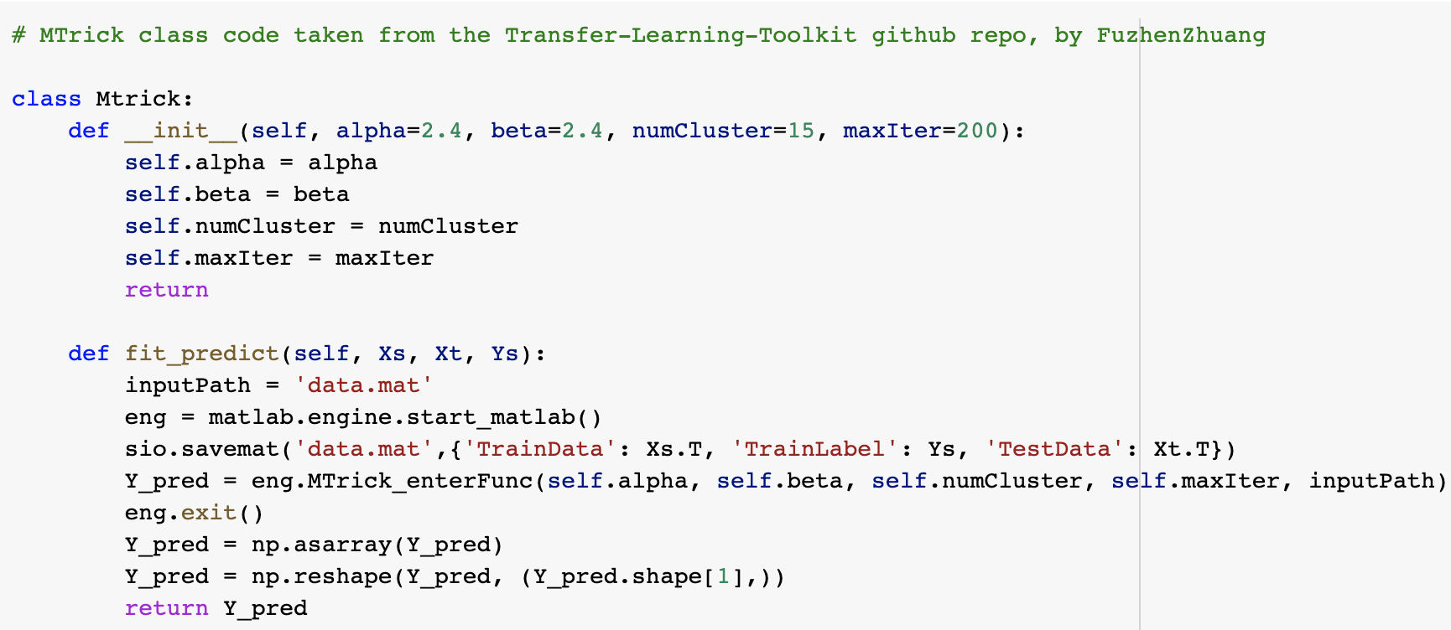
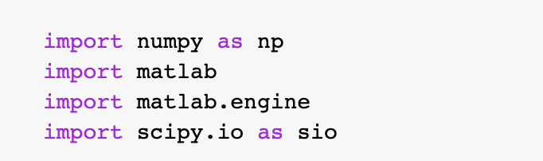
MTrick with Python & MATLAB
Importing MATLAB in Python
MTrick: Python with MATLAB backend
Notes:
In this code provided by the authors, Mtrick_enterfunc() is not a Python function, it is Matlab code housed in a dot m file. You can also see that you save the data as a Matlab format data file for it to use. The function returns an object that numpy is able to turn back into a regular array.

Slide 45
Ed Questions
Notes:
Now we move on to Q&A. However we will first address the question asked on ed.

Slide 46
TaskTrAdaBoost - Question
The authors justify the use of ensemble strategies such as TaskTrAdaBoost on the grounds that combining data from multiple product domains would not be successful because the data are generated from different distributions. Why then can we use models trained on ImageNet for medical applications, given that ImageNet does not contain medical images?

Slide 47
TaskTrAdaBoost – Response
There are multiple reason for the same:
Firstly, Keyword author uses is “may not work”
Secondly, ImageNet to Medical images is not a multi-source domain problem
Thirdly, don’t forget deep learning models do not work for every domain
Finally, amount of data required for models to learn similar level of generalization as (ImageNet Models), may not be available in the source domain
Our final thought:
How about combining TaskTrAdaBoost with Deep Learning Models

Slide 48
Questions Please!

Slide 49
Thanks!

Slide 50
Applications of TL
Transfer Learning
Transportation
Recommender Systems
Communication
Medical
Bioinformatics
Urban Computing
Detection
Classification
Diagnosis
Gene Expression
Biological Sequencing
Traffic Monitoring
Vehicle Recognition
Driver Behavior Modeling
Personalized Content
WiFi Localization
Energy Saving
Healthcare
Social Security
Speech Recognition

Slide 51
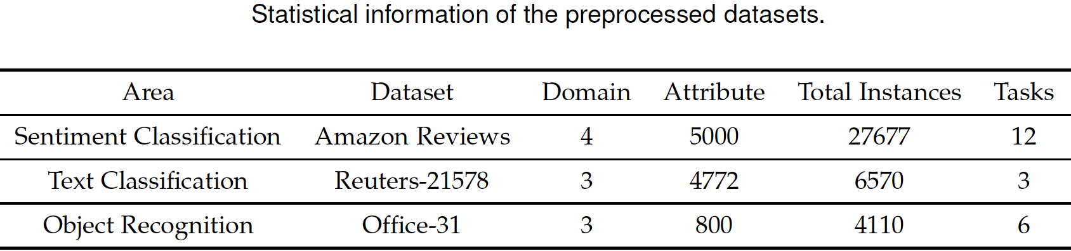
Experiments
Datasets
Setup
Three Datasets
Amazon Reviews (Sentiment)
Reuter-21578 (Text Categories)
Office-31 (Object Detection)
11 model across 12 experiments on Amazon Reviews
14 models across 6 experiments on Reuters-21578
8 models across 6 experiments on Office-31
20 different models evaluated
Results averaged across 3 trails

Slide 52
Amazon Reviews
Models that performed well in all 12 experiments
HDIC: feature reduction – clustering
SCL: feature selection
SFA: feature alignment
MTrick: feature reduction – clustering
SDA: feature encoding
Source domain: electronics or kitchen
All models did well
Domains may contain more transferable information

Slide 53
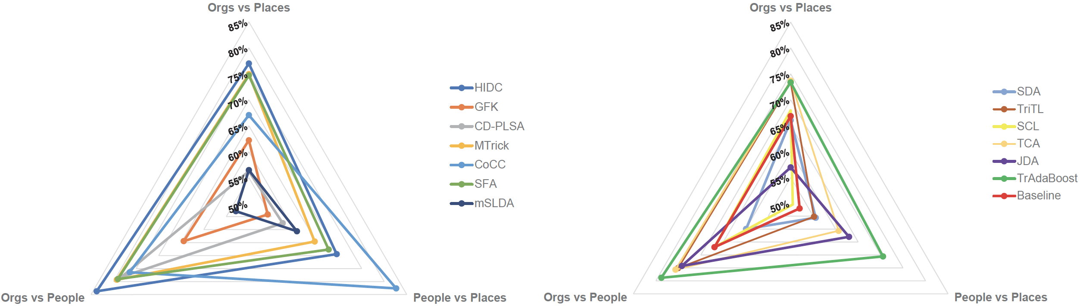
Reuters-21578
Orgs vs People and Orgs vs Places does better than People vs Places
HIDC, SFA, Mtrick are consistent across 3 tasks
CoCC does well on People vs Places as well

Slide 54
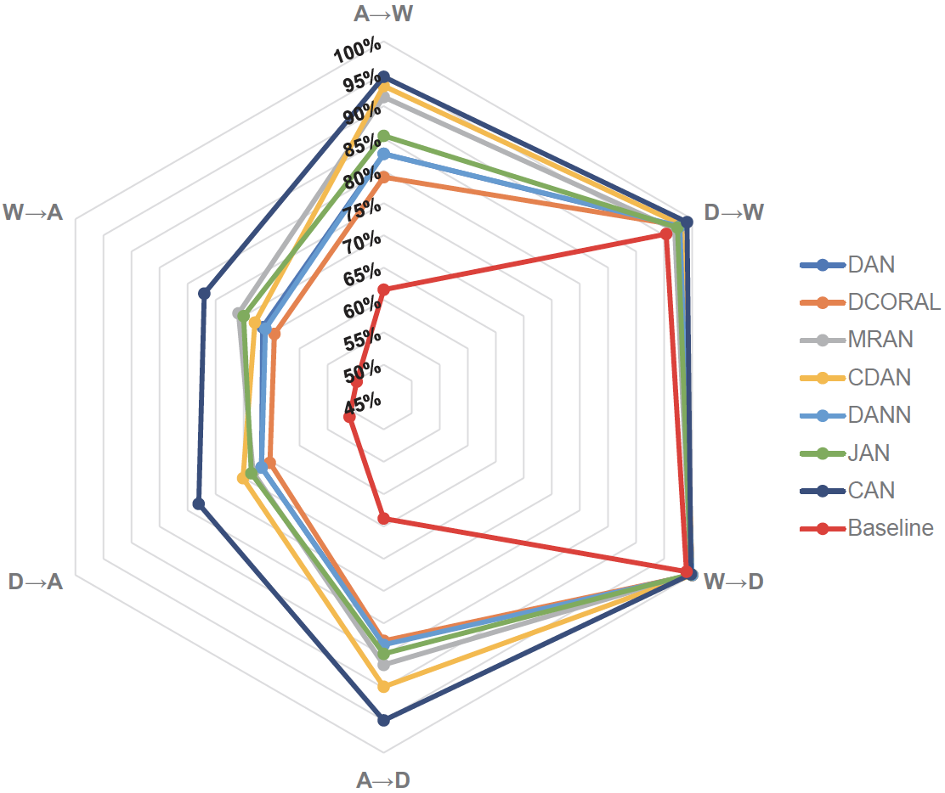
Office-31
All 7 algorithms have excellent performance on 2 tasks
D → W
W → D
WebCam and DSLR are more closely related with each other than Amazon
CAN outperforms other 6 algorithms
Adversarial Networks do a good job as well

Slide 55
Spectral Feature Clustering - Assumptions
Two domain-specific features are connected to many common domain-independent features
Then they tend to be very related
Will be aligned to same cluster with high probability
Two domain-independent features are connected to many common domain-specific features
Then they tend to be very related
Will be aligned to same cluster with high probability
We can find more compact and meaningful representation of domain-specific features which can reduce the gap between domains

Slide 56
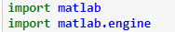
Running the MTrick Model – using Matlab (1)
The paper's authors provided the code to run all of their experiments via github
But some of them are coded in Matlab instead of Python
How to run these models
Install Matlab
In the /extern/engine/python/ folder under the Matlab root, run python setup.py install (with admin rights)
You will then have these libaries available

Slide 57
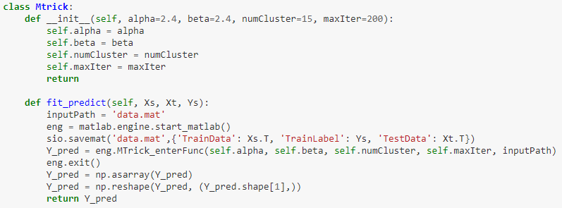
Running the MTrick Model – using Matlab (2)
In the below code from the github, the Mtrick_enterfunc is actually Matlab code stored in a .m file (it will also call several other functions that are in their own .m files)
You can also see that we save the data into .mat format in order for Matlab to be able to work with it
The function returns an object (predictions on the target domain data) which numpy is able to process into an array

